Slide 1
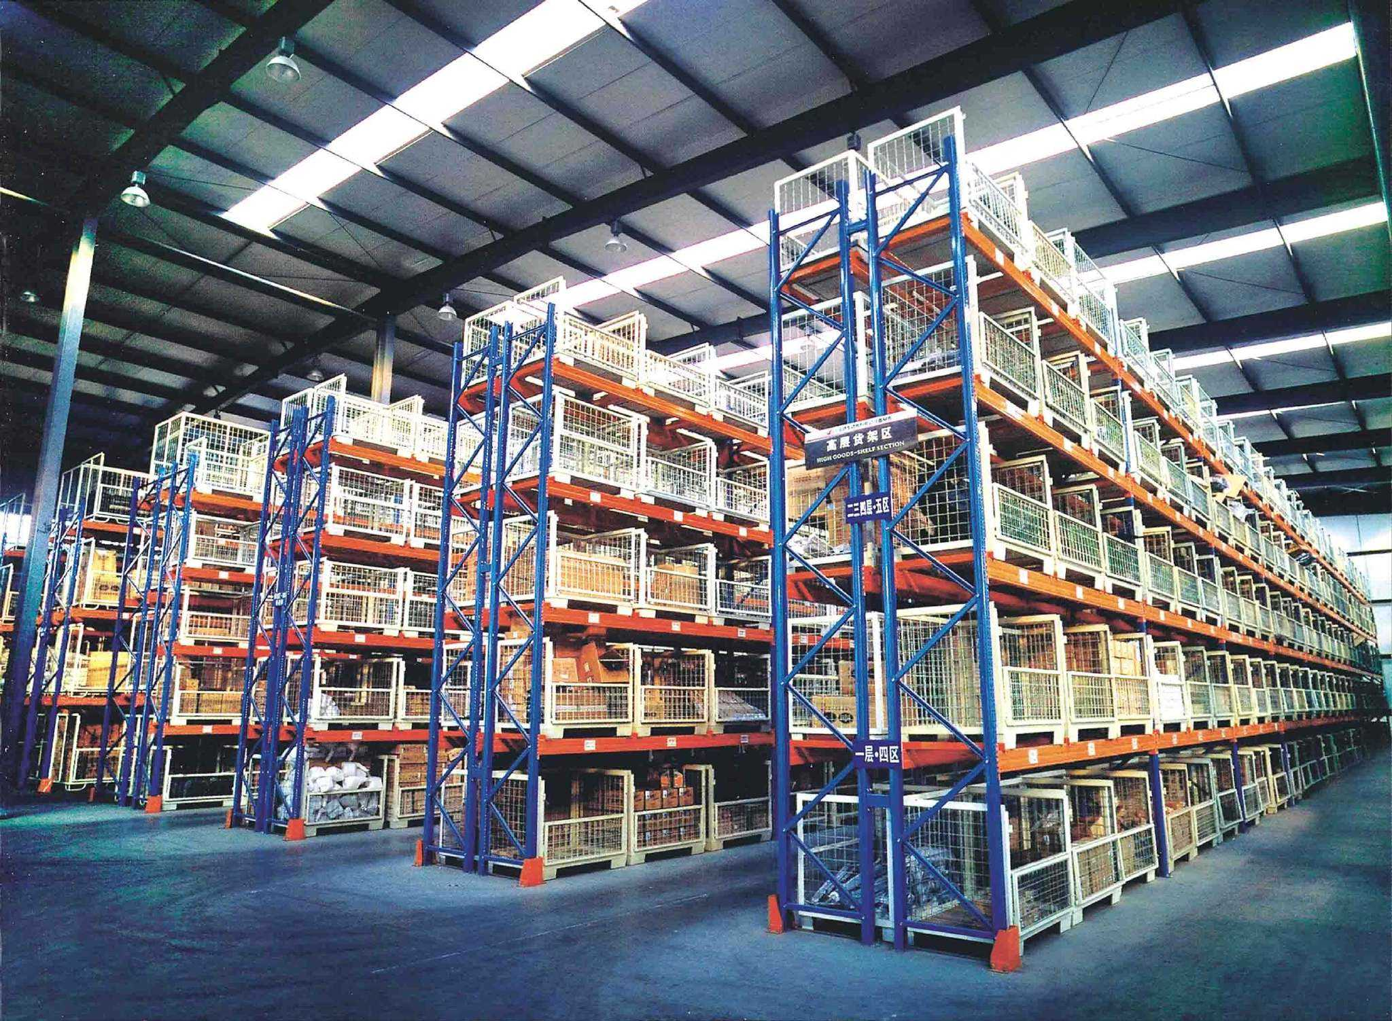
项目三
实施出库作业
合作企业与技术支持：

Slide 2
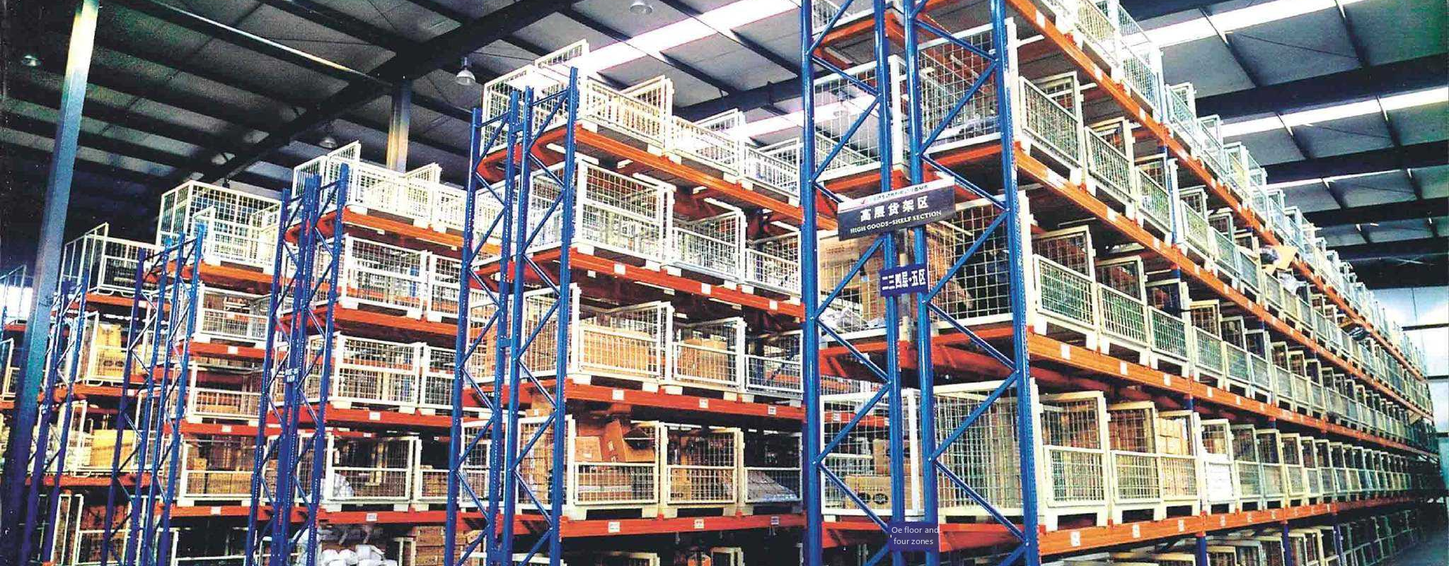
ChapterⅢ
Implementation of Outbound Operations
Partner Companies and Technical Support.

Slide 3
1
出库作业准备
目录
Contents
2
补货作业
3
拣货作业
4
验货作业
5
发运作业
合作企业与技术支持：

Slide 4
Catalog
1
Preparation of outbound operations
2
Replenishment operations
3
Picking operations
4
Inspection operations
5
Shipping operations
Partner Companies and Technical Support.

Slide 5
作业流程介绍
发运作业岗位人员及其职责
01

Slide 6
The operation process
The personnel of the shipping operation and their duties
01

Slide 7
一、人员职责表
B2B发运 | 配送司机 | 仓储发货组员 | 仓储发货组长 | 仓储库存组长 | 仓储验货组长 | 仓储拣货组长 | 货主客服专员
 | ①到达仓库找到实物后，核对调度【配送出库单】、“验货交接单”及实物，三者无差异后，签字并由发货组员复核。 ②待发货组员复核放行后，将货物拉出仓库，装车出发送货。 ③有缺货的单据，根据“验货交接单”上的缺货信息，核对实发数量与货物实物数量一致后，签字出库。 | ①对出库货物逐单复核，完成系统发运操作，并签字出库。 ②针对有缺货的单据，根据“验货交接单”上的缺货信息，核对实发数量与货物实物数量一致后，签字出库。 ③针对实物多于或少于单据数量的，将实物及单据交给发货组长协助跟进。 | ①实物多于单据数量，将单据及实物反馈至库存组长。 ②实物少与单据数量，检查发货暂存区是否出现货物遗漏，未找到遗漏货物，反馈给库存组长补货。 ③库存组长无法补拣货的单据，及时反馈至货主客服专员。货主客服专员经客户同意后，发货组长按照实物数量出库，并重新打印验货交接单。 | ①接收发货组长反馈的实物与单据不符信息，并进行实物拣选或退回操作，登记入“库存误差表”。 ②每天跟踪“库存误差表”。组织库存组盘点核对货物最终差异数量。 ②针对库存盘亏差异，代表仓储团队承担责任，制定改善办法，并接受货主考核。 | ①根据“拣货验货误差表”，跟进验货组员改善工作，并负责制定工作误差考核办法。 | ①根据“拣货验货误差表”，跟进拣货组员改善工作，并负责制定工作误差考核办法。 | ①接到因库存原因，导致客户订货出现差异时，与收货客户沟通送货差异。 ②与客户沟通一致后，通知仓储团队继续发货。 ③将缺货信息记录在“订单缺货表”中。并有权利对仓储团队制定工作误差考核办法。

Slide 8
Ⅰ. Schedule of duties of personnel
B2B shipping | Distribution drivers | Warehouse shipping team member | Warehouse Shipping Team Leader | Warehouse Inventory Team Leader | Warehouse Inspection Team Leader | Warehouse Picking Team Leader | Shipper Customer Service Specialist
 | ①After arriving at the warehouse and finding the real thing, check the scheduling [distribution out of the warehouse], "goods inspection and handover sheet" and the real thing, and after there is no discrepancy between the three, sign and review by the delivery team members. ② After checking and releasing the goods by the shipping team, pull the goods out of the warehouse and load the trucks for delivery. ③ If there are out-of-stock documents, according to the out-of-stock information on the "Goods Inspection and Handover Sheet", after checking that the actual quantity issued is the same as the physical quantity of the goods, the goods will be signed out of the warehouse. | ①Review the outgoing goods one by one, complete the system shipment operation, and sign the outgoing goods. ② for out-of-stock documents, according to the "goods inspection handover" on the out-of-stock information, check the actual number of goods issued and the number of goods in kind is consistent with the signature out of the warehouse. ③ If the number of physical goods is more or less than the number of documents, the physical goods and the documents will be handed over to the head of the shipment team to assist in the follow-up. | ① If the quantity of goods is more than the number of receipts, send the receipts and the goods back to the head of the inventory team. ② physical less than the number of documents, check the delivery of goods in the temporary storage area whether there are goods missing, did not find the missing goods, feedback to the inventory team leader to replenish the goods. ③ Inventory team leader can not make up the sorting documents, timely feedback to the owner of the customer service commissioner. The owner of the customer service commissioner agreed by the customer, the head of the delivery team in accordance with the physical quantity of goods out of stock, and re-print the inspection handover sheet. | ①Receive the information of discrepancy between the physical goods and the documents from the head of the shipping team, and carry out the operation of picking or returning the physical goods, and register it in the "Inventory Error Table". ②Track the "Inventory Error Table" on a daily basis. Organize inventory team to check the final discrepant quantity of goods. ② In response to the inventory loss discrepancy, on behalf of the warehousing team to take responsibility for the development of improvement methods, and accept the assessment of the shipper. | According to the "picking and inspection error table", follow up the improvement work of the inspection team members, and be responsible for the development of work error assessment methods. | According to the "picking and inspection error table", follow up the improvement work of the picking team members, and be responsible for the development of work error assessment methods. | ①When there is a discrepancy in the customer's order due to inventory, communicate with the receiving customer about the delivery discrepancy. ②After communicating with the customer, notify the warehouse team to proceed with the shipment. ③ Record the out-of-stock information in the "order out-of-stock table". And have the right to set up work error assessment methods for the warehouse team.

Slide 9
作业流程介绍
发运作业流程
02

Slide 10
The operation process
Shipping operation process
02

Slide 11
二、发运作业流程图

Slide 12
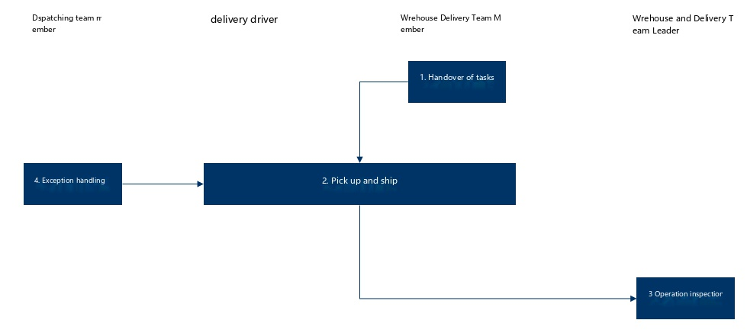
II. Flowchart of shipping operations
Dispatching Team Member
Delivery Driver
Warehouse Delivery Team Member
Warehouse Delivery Team Leader

Slide 13
作业流程介绍
具体实施步骤
03

Slide 14
The operation process
Specific implementation steps
03

Slide 15
1.任务交接
验货组员验货完成，通知发货组员准备发运。为防止验货遗漏问题，需尽快完成发运，当天完成验货的最迟在第二天上午完成发运。

Slide 16
1. Handover of tasks
When the goods inspection team completes the inspection, the shipping team is notified to prepare for shipment. In order to prevent problems from being missed during the inspection, the shipment should be completed as soon as possible, and if the inspection is completed on the same day, the shipment should be completed by the next morning at the latest.
Figure 1.1

Slide 17
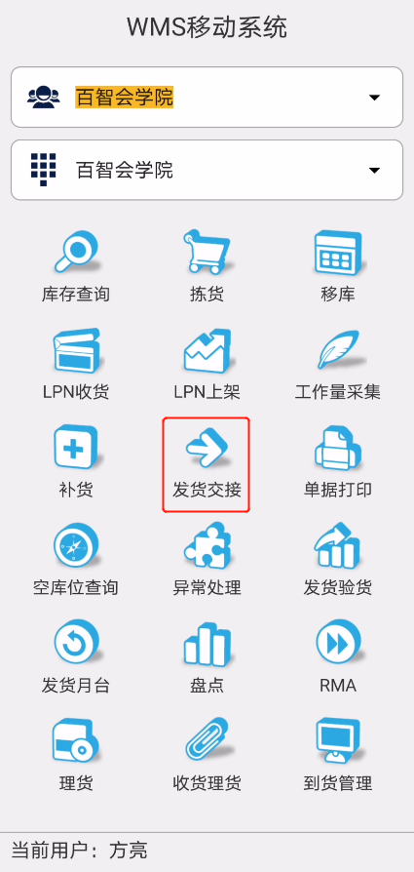
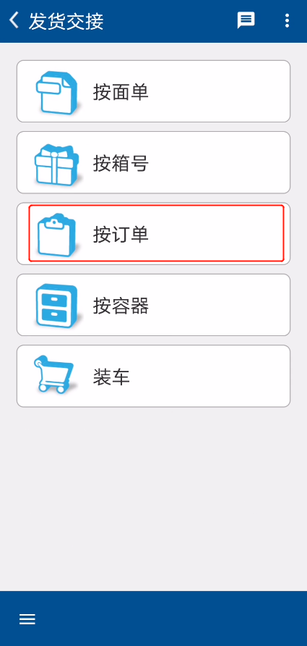
2.提货发运
（1）司机到达仓库后，首先填写“司机登记表”，再进入发货暂存区提货。
（2）司机根据调度指令，到指定月台找到货物，拿取“验货交接单”。
（3）司机清点货物明细，查询实物数量与“验货交接单”是否一致，确认无误后，将货物搬运至仓库出口与发货组员进行复核。
（4）发货组员与司机在仓库出口的发运交接区对照“验货交接单”，复核出库货物，清点箱数。核对一致后，由双方在“验货交接单”上签字。之后发货组员在RF终端完成发货交接（图3.5.2）。
（5）交接完毕后放行，司机将货物拉出仓库，装车并出发送货。
图3.5.2 发货交接

Slide 18
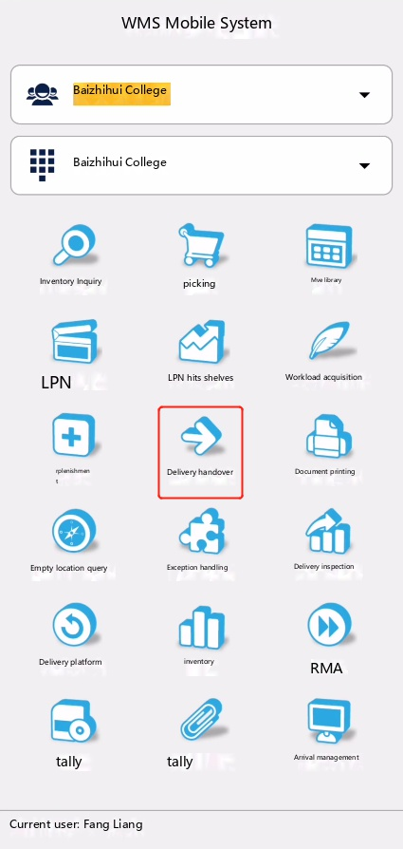
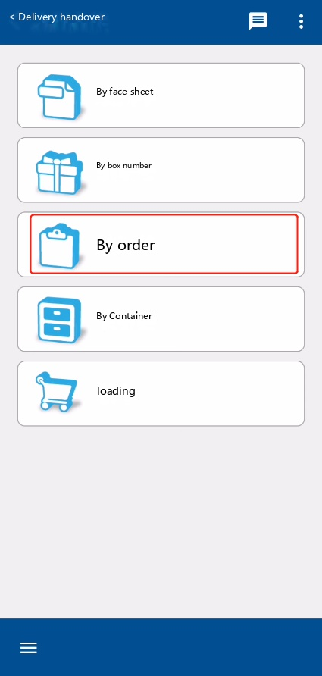
2. Pick-up and shipment
(1) Drivers arrive at the warehouse, first fill out the "driver registration form", and then enter the delivery of temporary storage area to pick up goods.
(2) According to the dispatching instructions, the driver will go to the designated platform to find the goods and take the "cargo inspection and handover sheet".
(3) The driver counts the details of the goods, inquires whether the physical quantity is consistent with the "cargo inspection and handover sheet", confirms that there is no error, and then carries the goods to the warehouse outlet and the delivery team member for review.
(4) Shipping team members and drivers in the warehouse export shipping handover area against the "cargo inspection handover sheet", review the goods out of the warehouse, count the number of boxes. After checking the consistency, both parties will sign on the "Cargo Inspection and Handover Order". After that, the delivery team members will complete the delivery handover at the RF terminal (Figure 3.5.2).
(5) After the handover is completed and released, the driver pulls the goods out of the warehouse, loads the truck and departs for delivery.
Figure 3.5.2 Shipment handover

Slide 19
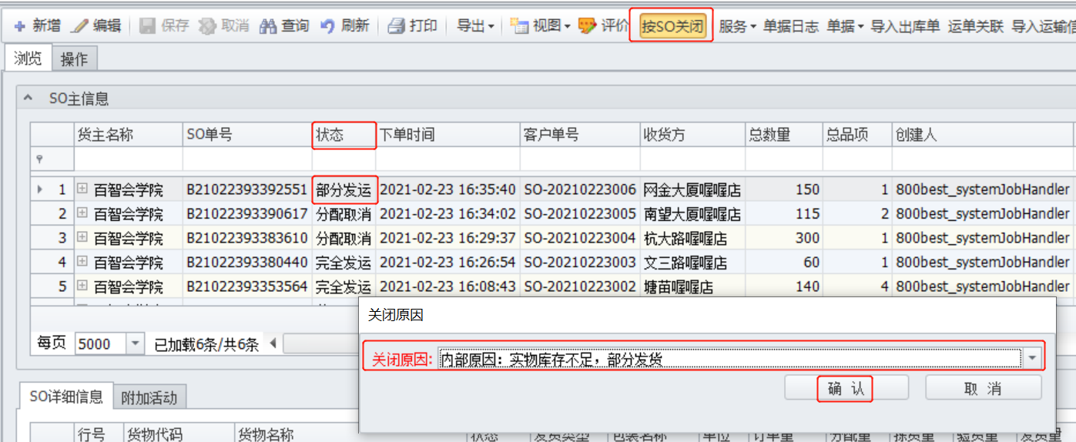
3.作业检查
发运作业完成，配送司机拉货出仓开始配送作业。发货组长每天在电脑端【WMS】检查发货状态是否为完全发运。针对部分发运的，查找原因，并登记至“部分发运表”进行跟踪。如因库存缺货导致状态为“部分发运”的，可直接进行系统关单处理（图3.5.3）。
图3.5.3 订单发运查看及关单处理

Slide 20
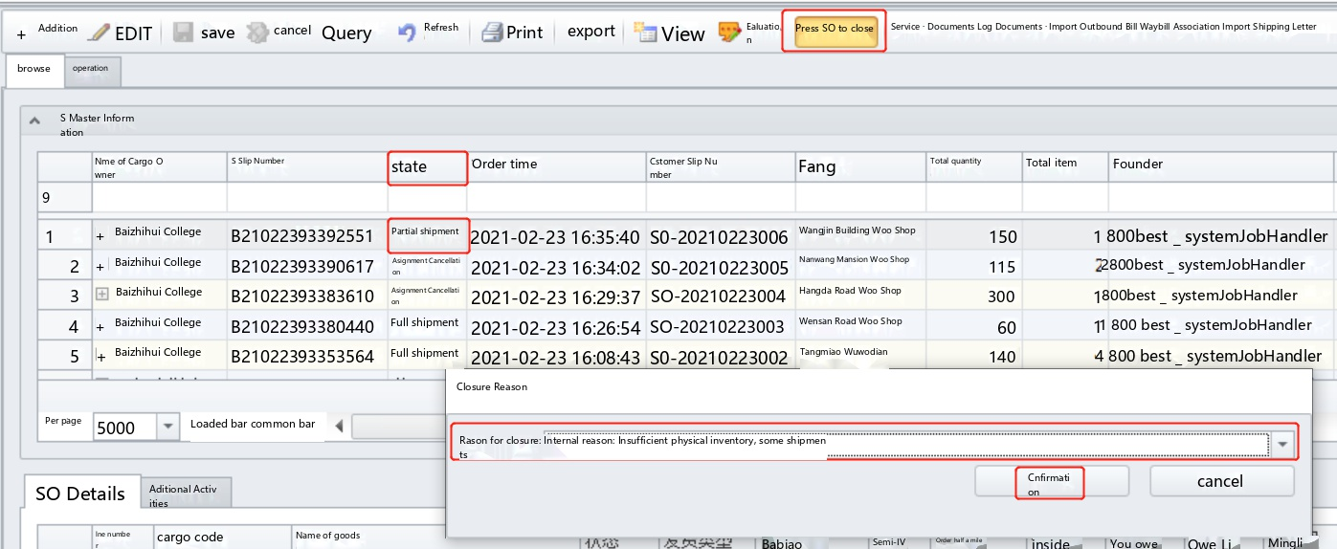
3. Inspection
After the delivery operation is completed, the delivery driver pulls the goods out of the warehouse and starts the delivery operation. The delivery team leader checks whether the delivery status is complete delivery on the computer [WMS] every day. For partial shipments, find out the reasons and register them in the "Partial Shipment Table" for tracking. If the status is "Partial Shipment" due to stock shortage, the system can directly close the order (Figure 3.5.3).
Figure 3.5.3 Inspection of Order Shipment and Processing of Customs Clearance

Slide 21
4.异常处理
（1）“配送出库单”与“验货交接单”不一致
配送司机清点货物时，发现“配送出库单”任务明细与“验货交接单”不一致。司机应以“验货交接单”的信息做揽收数量上报，并反馈至调度组员，由调度组员与货主客服专员核对信息，进行修改。
（2）实物数量少于“验货交接单”数量
司机清点时发现货物实物数量与“验货交接单”不一致，实物数量少于单据数量，应按如下步骤处理：
① 司机将差异明细反馈至发货组员。
② 发货组员对发货暂存区的其他月台进行货物清点，确认是否有遗漏货物。如找到该货物，继续发运操作。
③ 如仍未找到，将单据信息、少货明细，反馈至库存组员处理。
④ 库存组员补拣货物，并交发货组员复核。将验货人、拣货人信息登记至“拣货验货误差表”中，反馈至验货组长与拣货组长处理。

Slide 22
4. Exception handling
(1) The "Delivery Outbound Order" is inconsistent with the "Inspection Handover Order"
When the delivery driver counted the goods, he found that the task details of the "delivery outbound order" were inconsistent with the "inspection handover order". The driver should report the collected quantity according to the information in the "Inspection Handover Order" and feed it back to the dispatcher, who will check the information with the customer service specialist of the owner and make modifications.
(2) The physical quantity is less than the quantity of "Inspection Handover Order"
When the driver checks, he finds that the physical quantity of the goods is inconsistent with the "Inspection Handover Order", and the physical quantity is less than the document quantity, which should be handled according to the following steps:
① The driver feeds back the difference details to the delivery team members.
② The delivery team members shall count the goods on other platforms in the delivery temporary storage area to confirm whether there are any missing goods. If the goods are found, continue the shipping operation.
③ If it is still not found, the document information and the details of the shortage will be fed back to the inventory team for processing.
④The inventory team member picks up the goods and submits them to the shipping team member for review. Register the information of the inspector and picker in the "Picking Inspection Error Table", and feedback it to the inspection team leader and the picking team leader for processing.

Slide 23
4.异常处理
⑤ 如果库货组员发现所缺货物没有库存，无法补拣的，将库存缺货信息登记在“库存误差表”，并反馈至发货组长及库存组员。
⑥ 发货组长将“发货订单”缺货信息反馈至货主客服专员处理（同验货异常处理）。
⑦ 待货主客服专员同意按照差异数量出库后，发货组长通知验货组员重新打印验货交接单。
⑧ 发货组员在最新的“验货交接单”上签字（姓名、电话、出库时间），并将“验货交接单”交给司机复核签字（包含：姓名、电话，配送车牌号、提货时间）。

Slide 24
4. Exception handling
⑤ If the warehouse crew finds that the missing goods are out of stock and cannot be replenished, they will register the information of stock shortage in the "Inventory Error Table" and feed it back to the delivery team leader and the inventory crew.
⑥ The delivery team leader feeds back the out-of-stock information of the "delivery order" to the owner's customer service specialist for handling (the same as handling abnormal inspection).
⑦ After the owner's customer service commissioner agrees to release the goods in accordance with the difference in quantity, the head of the shipment team notifies the inspection team to reprint the goods inspection handover sheet.
⑧ The delivery team members sign the latest "inspection handover order" (name, telephone, delivery time), and hand over the "inspection handover order" to the driver for review and signature (including: name, telephone number, delivery license plate number, pick-up time).

Slide 25
4.异常处理
（3）实物数量多于“验货交接单” 数量
司机清点时发现货物实物数量与“验货交接单”不一致，实物数量多于单据数量，应按如下步骤处理：。
① 司机将差异信息反馈至发货组员。
② 发货组员复核后，将货物实物与“验货交接单”的差异信息反馈至发货组长处理。
③ 发货组长将单据信息、多出货物，交给库存组长。库存组长将多拣货物退回拣选区，将验货人、拣货人信息登记至“拣货验货误差表”中，反馈至验货组长与拣货组长处理。
④ 如果未找到有库位缺货，该货物应视为盘盈。库存组长将盘盈信息登记在“库存误差表”中 。

Slide 26
4. Exception handling
(3).The physical quantity is more than the quantity of the "goods inspection and handover sheet"
If the driver's count reveals that the physical quantity of the goods does not correspond to the "goods inspection and handover sheet" and that the physical quantity is greater than the documented quantity, the following steps should be taken:.
① The driver feeds back the discrepancy information to the shipping team member.
② After reviewing the goods, the shipping team member will feedback the discrepancy information between the goods and the "goods inspection and handover order" to the shipping team leader.
③ The shipping team leader gives the information of the documents and the overpicked goods to the inventory team leader. The inventory leader returns the overpicked goods to the picking area, registers the information of the inspector and the picker in the "Picking and Inspection Error Table", and sends it back to the inspection leader and the picking leader for processing.
④ If no out-of-stock item is found, the item should be considered as inventory surplus. The inventory leader registers the inventory surplus information in the "Inventory Error Sheet".

