Slide 1
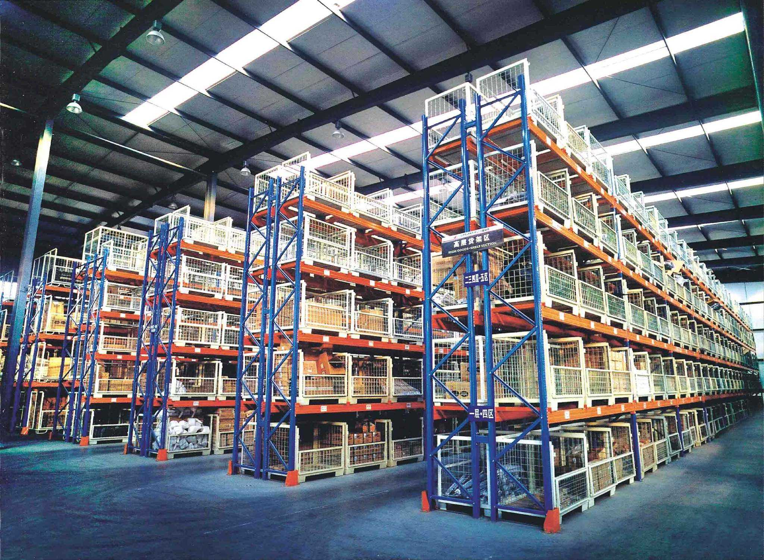
项目三
实施出库作业
合作企业与技术支持：

Slide 2
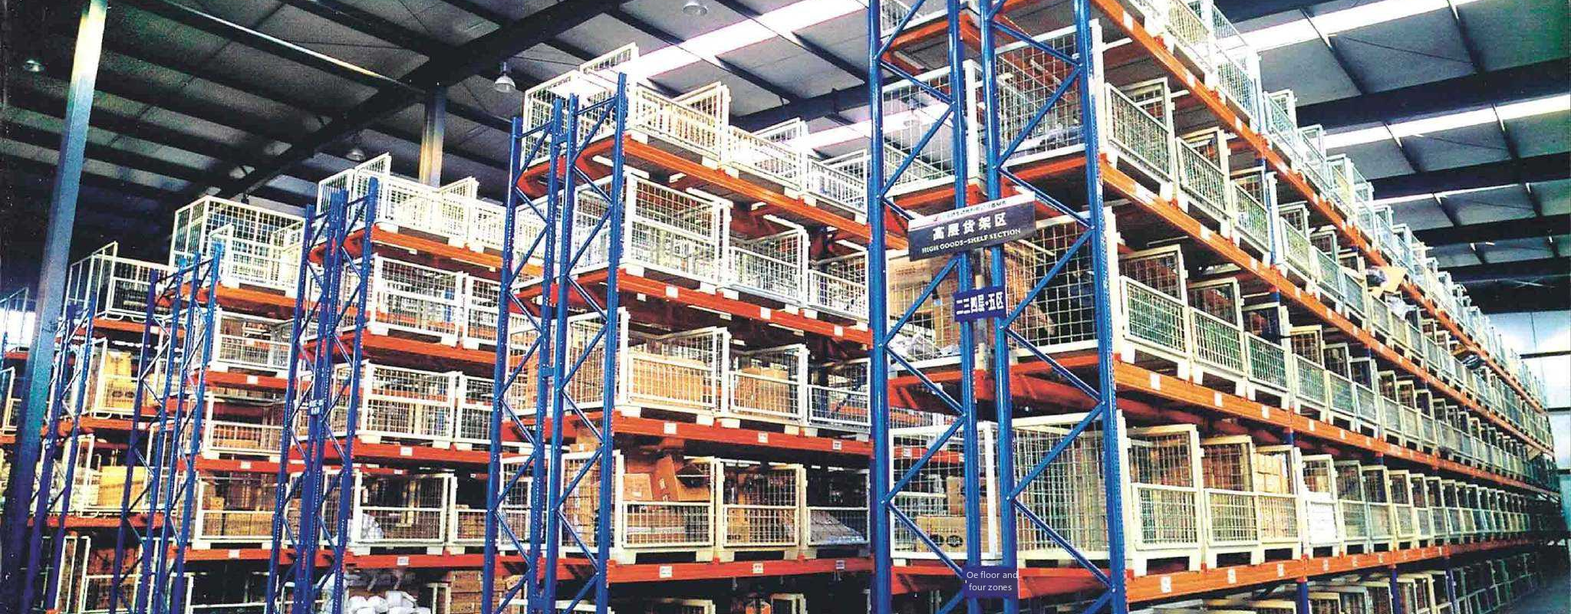
ChapterⅢ
Implementation of Outbound Operations
Partner Companies and Technical Support.

Slide 3
目录
1
出库作业准备
Contents
2
补货作业
3
拣货作业
4
验货作业
5
发运作业
合作企业与技术支持：

Slide 4
Catalog
1
Preparation of outbound operations
2
Replenishment operations
3
Picking operations
4
Inspection operations
5
Shipping operations
Partner Companies and Technical Support.

Slide 5
一、接收客户订单
1.接收订货
客户通过传统订货方式或者电子订货方式发出订货请求。传统订货有业务员跑单接单、厂商补货、厂商巡视隔日送货、电话口头订货、传真订货、邮寄订单、客户自行取货等多种形式，但随着信息技术的发展，基于互联网的电子订货系统逐渐取代了传统订货方式。

Slide 6
I. Receiving customer orders
Preparation of outbound operations
1. Receiving orders
The customer places an order request through a traditional order method or an electronic order method. Traditional ordering has a salesman to run orders, manufacturers replenishment, manufacturers to inspect the next day delivery, telephone oral ordering, fax ordering, mail orders, customers pick up the goods and other forms, but with the development of information technology, the Internet-based electronic ordering system has gradually replaced the traditional ordering method.

Slide 7
2.出库通知单
表3.1.1 出库通知单
仓库名称： 烟台国际物流港1号 时间： 2024年8月10日
采购订单号 |  |  |  | 202408100010
客户指令号 |  | 20240810010 |  | 订单来源 |  | 系统导入
客户名称 |  | 东岳汽车配件有限公司 |  | 质 量 |  | 正品
出库方式 |  | 自提 |  | 出库类型 |  | 正常
序号 | 货品编号 | 名称 | 单位 | 产品规格（个） | 申请数量 | 实发数量 | 备注
1 | 9787799630021 | 滤清器 | 个 | 1×5 | 10
2 | 9787880798180 | 火花塞 | 个 | 1×5 | 30
3 | 9787799627281 | 车灯 | 个 | 1×5 | 20
4 | 9787543057388 | 汽车喇叭 | 个 | 1×5 | 20
合 计 |  |  | 80
制单人：李蜜 提货人：刘宇宏 仓管员：王礼

Slide 8
Preparation of outbound operations
2. Outbound notification forms
Table 3.1.1 Outbound notification forms
Warehouse Name: Yantai International Logistics Port No. 1 Time: August 10, 2024
Purchase order number |  |  |  | 202408100010
Customer instruction number |  | 20240810010 |  | The source of the order |  | System import
Customer name |  | Dongyue Auto Parts Co |  | Quality |  | Genuine
Outbound method |  | Self-pickup |  | The type of outbound operations |  | Normal
Serial number | Goods number | Name | Unit | Product specification (pcs) | Number of applications | Quantity issued | Remarks
1 | 9787799630021 | Filters | individual | 1×5 | 10
2 | 9787880798180 | Spark plugs | individual | 1×5 | 30
3 | 9787799627281 | Headlights | individual | 1×5 | 20
4 | 9787543057388 | Car horn | individual | 1×5 | 20
Total |  |  | 80
Producer: Li Mi, Lifter: Liu Yuhong, Warehouse Manager: Wang Li

Slide 9
2.订单确认
订货信息到达以后，仓储部需要进行订单确认，主要确认内容包括：
①订货信息：主要包括客户名称、客户编码、货物名称、商品编号、提货数量、货物规格及出库日期等。
②客户的信用：一般情况下，配送中心都是先送货，然后按月结算货款，那么客户的信用就显得尤为重要。根据客户的信用表现为客户分配信用额度，如超出信用额度，则订单列为无效订单。

Slide 10
Preparation of outbound operations
2. Order confirmation
After the arrival of the order information, the warehouse department needs to carry out order confirmation, the main confirmation includes:
①Ordering information: mainly includes customer name, customer code, goods name, commodity number, pick-up quantity, goods specifications and date of shipment.
②Customer credit: In general, the distribution center is the first delivery, and then monthly settlement of payments, so the customer's credit is particularly important. According to the credit performance of the customer, the credit limit is assigned to the customer, and if the credit limit is exceeded, the order is classified as invalid.

Slide 11
二、制定库存分配计划
1.库存查询
存货查询是指检查库存状况，包括库存是否有客户需要的货物品种和数量，以及是否有能力在规定的日期完成配送。
2．库存分配
订单分配的方式有两种：一是单一订单分配，适用于追求时效的大客户；二是批次订单分配，就是把收到的订单按不同时间段集成一批，统一分配，适用于需求量少的普通客户。库存充足时，无论哪种方式都能够有效保证客户的需求。库存不足时单一订单会按时间顺序进行优先分配，而批次订单则需要考虑客户的交易规模、信用状况等因素进行分配。对于无法满足需求的订单，需要与客户做好沟通协调，寻求妥善的处理方法。

Slide 12
Ⅱ. Develop the inventory allocation plan
Preparation of outbound operations
1. Inventory inquiries
Inventory inquiry refers to the checking of inventory status, including the availability of goods in stock in the varieties and quantities required by the customer and the ability to complete the delivery by the specified date.
2. Inventory allocation
There are two ways of order allocation: one is a single order allocation, applicable to the pursuit of time-sensitive large customers; the second is the batch order allocation, that is, the orders received by the different time periods of integration of a batch of unified allocation, applicable to ordinary customers with low demand. When the inventory is sufficient, either way can effectively ensure customer demand. When the inventory is insufficient, single orders will be prioritized in chronological order, while batch orders need to be allocated, taking into account the customer's transaction size, credit status and other factors. For orders that cannot be fulfilled, it is necessary to communicate and coordinate with the customer to find a proper way to deal with them.

Slide 13
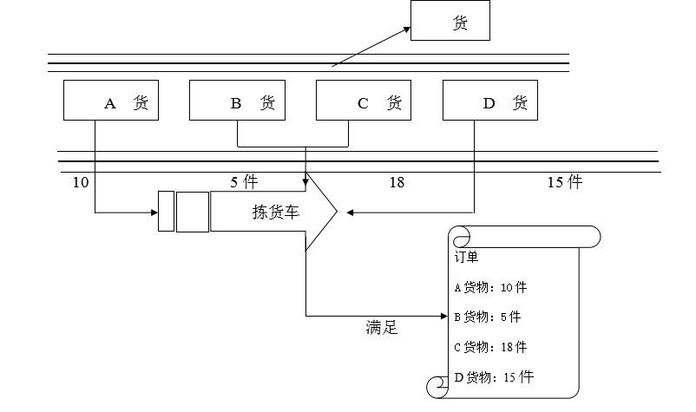
三、确定拣货方式
根据客户订单品项、库存分布情况，以提高拣货效率、降低拣货成本为原则，确定拣货方式。
1.订单拣取
又称摘果法，订单拣取针对每份订单，分拣人员按照订单所列商品及数量，将商品从储存区域或分拣区域取出，然后集中在一起。
图3.1.1 订单拣取流程示意图

Slide 14
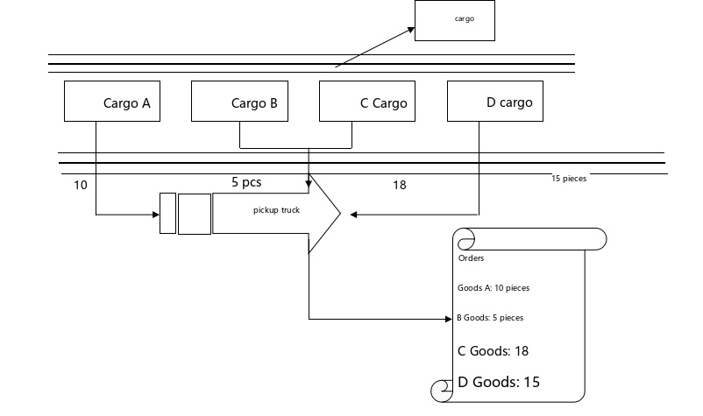
Ⅲ. Determining the picking method
Preparation of outbound operations
According to the customer's order items and inventory distribution, we determine the picking method based on the principle of improving picking efficiency and reducing picking cost.
1. Order picking
It is also known as the fruit picking method. The order picking is for each order, and the sorting personnel take out the goods from the storage area or sorting area according to the goods and quantities listed in the order, and then gather them together.
Figure 3.1.1 Schematic diagram of the order picking process

Slide 15
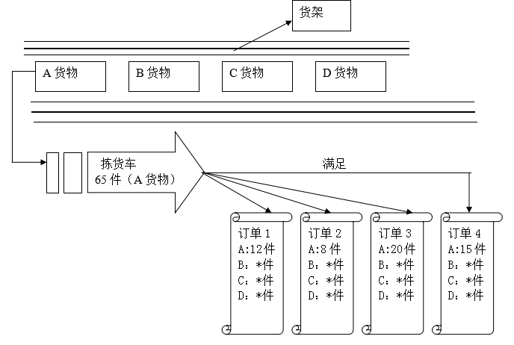
2.批量拣取
又称播种法，将多张订单集合成一批，按照商品品种、类别加总、拣货，然后依据不同客户或不同订单分类集中。
拣选车
55件（A货物）
图3.1.2 批量拣取示意图

Slide 16
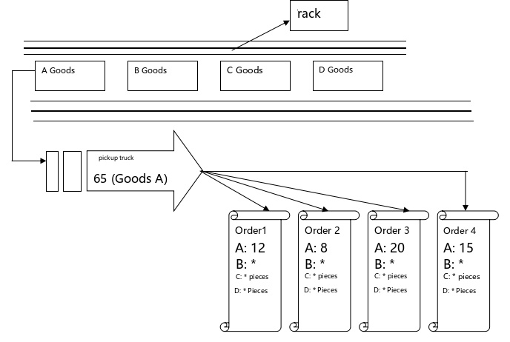
Preparation of outbound operations
2. Batch picking
It is also known as the seeding method. It is the collection of multiple orders into a batch, according to the variety of goods, categories, totaling, picking, and then categorized and centralized based on different customers or different orders.
Picking carts
55 (Goods A)
Figure 3.1.2 Schematic diagram of batch picking

Slide 17
3.复合拣取
可以将订单拣取和批量拣取组合起来的拣取方式。根据订单的品种、数量及出库频率，决定哪些订单适用于按订单拣取，哪些订单适用于批量拣取。

Slide 18
Preparation of outbound operations
3. Compound picking
This is a picking method that combines order picking and batch picking. Depending on the type and quantity of the order and the frequency of shipment, it is determined which orders are suitable for order picking and which orders are suitable for batch picking.

Slide 19
表3.1.2 不同拣货方式的优缺点比较
拣货方式 | 优点 | 缺点 | 适用范围
订单拣取 | ① 作业方法简单。 ② 作业前置时间短。 ③ 作业人员责任明确，易于安排人力。 ④ 拣货后不用进行分类作业，适用于配送批量大的订单的处理。 ⑤ 导入容易，作业弹性大。 | ① 商品品类多时，拣货行走路径加长，拣货效率降低。 ② 拣货区域大时，搬运系统设计困难。 ③ 少量多次拣取时造成拣货路径重复，效率降低。 | ① 用户不稳定波动较大。 ② 用户之间共同需求差异较大。 ③ 用户需求种类较多，不便于统计和共同取货。 ④ 用户的配送时间有明确要求且要求不一。 ⑤ 传统仓库改建成的配送中心。
批量拣取 | ① 提高计划规模，降低计划成本 。 ② 可以缩短拣货时的行走时间，增加单位时间的拣货量。 ③ 节省人力，减少与其他作业的冲突。 | ① 对紧急订单无法做及时的处理。 ② 积累订单数量时，延长停滞时间。 ③ 增加分货作业。 ④ 必须全部作业完成后才能发货。 | ① 用户稳定，数量较多。 ② 用户之间共同需求大。 ③ 用户需求种类较少，便于统计和共同取货。 ④ 用户的配送时间没有明确要求。 ⑤ 专业性强的配送中心。

Slide 20
Preparation of outbound operations
Table 3.1.2 Comparison of the advantages and disadvantages of different picking methods
Picking method | Pros | Cons | Scope of application
Order Picking | ① The method of operation is simple. ② Short lead time for assignments. ③ Operators' responsibilities are clearly defined, making it easy to organize manpower. ④ No sorting is required after picking, so it is suitable for orders with a large delivery batch. ⑤ Easy to introduce and flexible in operation. | ① When there are many product categories, the picking path is longer and the picking efficiency is reduced. ② When the picking area is large, it is difficult to design the handling system. (iii) When picking a small number of times, the picking path is duplicated and the efficiency is reduced. | ① Large fluctuations in user instability. ② Large differences in common needs among users. ③ The variety of user requirements does not allow for statistics and common pickups. ④ Users have clear and varying requirements for delivery times. ⑤ Distribution centers converted from traditional warehouses.
Batch picking | ① Increase program size and reduce program costs. ② Shorten the traveling time when picking and increase the picking volume per unit time. (iii) Save labor and reducing conflicts with other operations. | ① Urgent orders cannot be processed in a timely manner. ② When the number of orders is accumulated, the standstill time is extended. ③ Increase in stock separation operations. ④ All must be completed before shipment. | ① Stable and large number of users. ② Large common needs among users. ③ Fewer types of user requirements, facilitating statistics and common pickups. ④ The user's delivery time is not explicitly requested. ⑤ Specialized distribution centers.

Slide 21
谢谢观看

Slide 22
Thanks for listening

