Slide 1
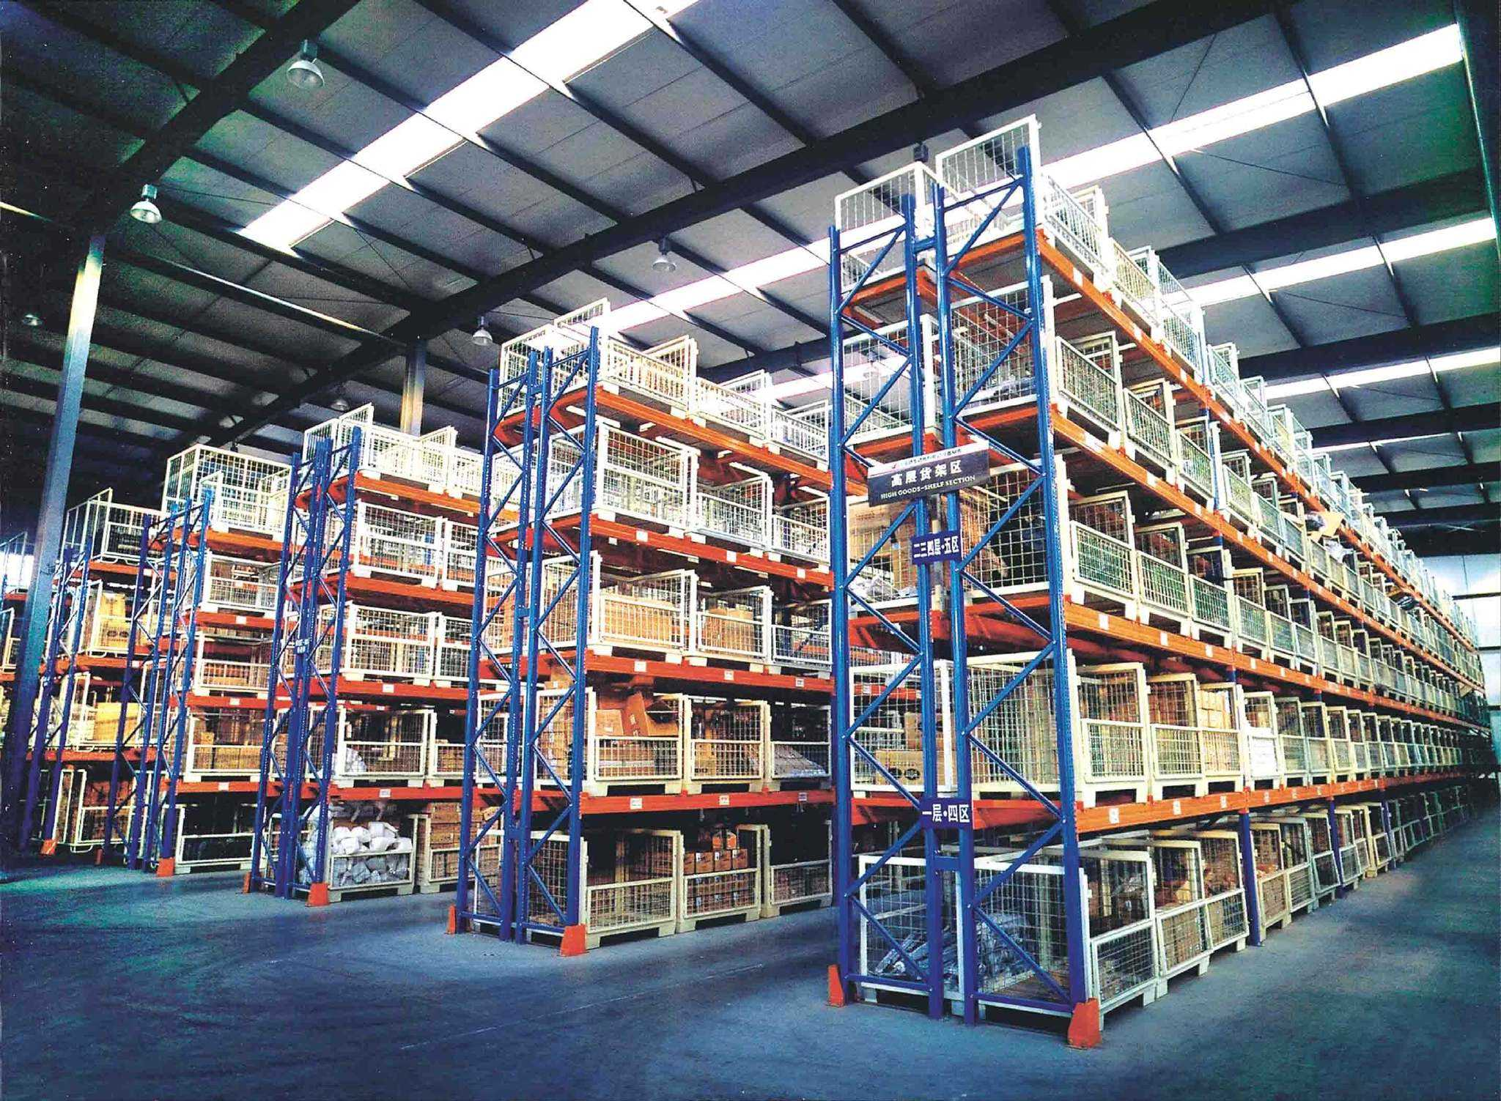
项目一
实施入库作业
合作企业与技术支持：

Slide 2
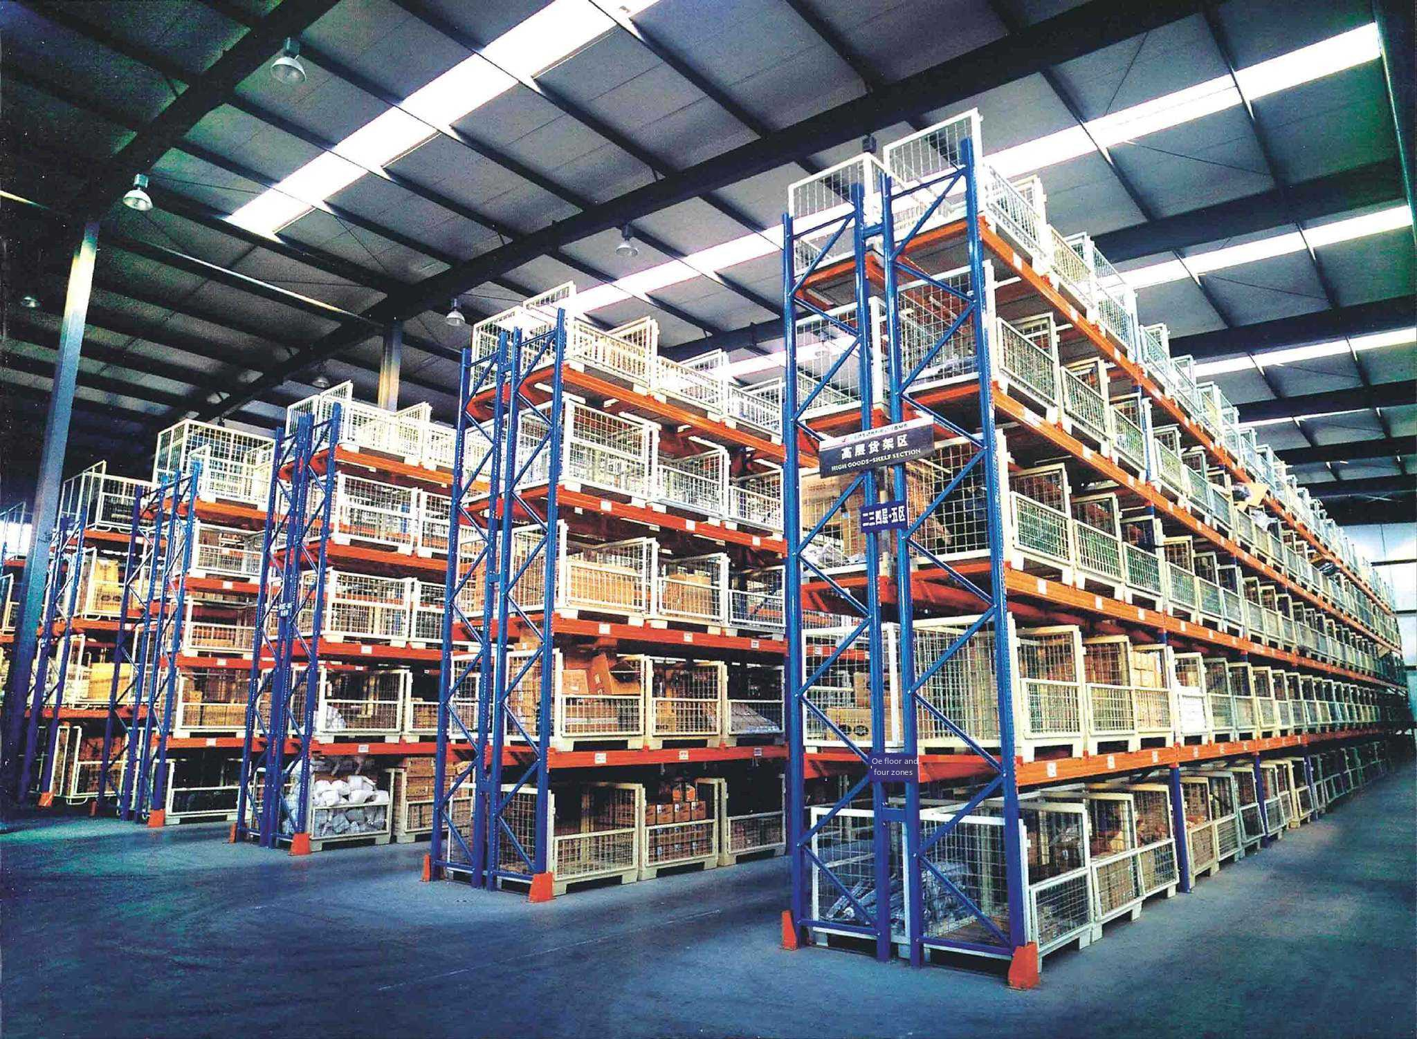
Chapter I
Implementation of Warehousing Operations
Partner Companies and Technical Support.

Slide 3
目录
1
入库作业准备
Contents
2
采购收货作业
3
销售退货收货作业
4
货物上架作业
合作企业与技术支持：

Slide 4
Catalog
1
Preparation for warehousing operations
2
Purchasing & receiving operations
3
Sales return & receipt operations
4
Goods shelving operations
Partner Companies and Technical Support.

Slide 5
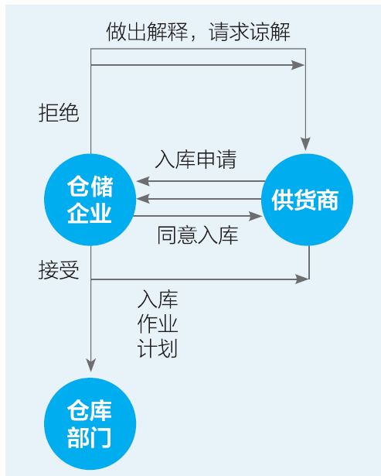
一、入库申请
入库作业准备
1.入库申请认知
入库申请是生成入库作业计划的基础和依据，是存货人（供货商）对仓储服务产生需求，并向仓储企业发出的需求通知。入库申请流程如图 3-1 所示。
图 3-1 入库申请流程

Slide 6
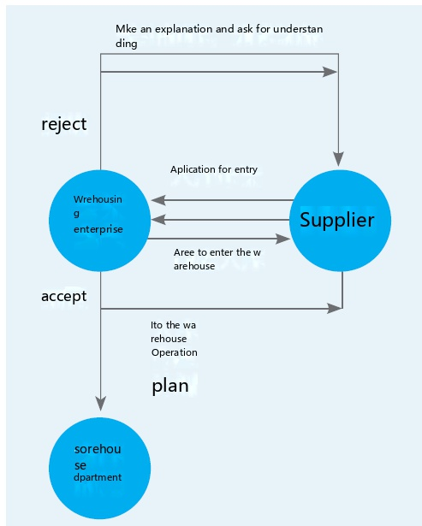
I. Warehousing Application
Preparation for warehousing operations
Make an explanation and ask for understanding
1. Recognition of Warehousing Application
Warehousing application is the basis for the generation of warehousing operation plan and it is the demand notice issued by the stockist (supplier) to the warehousing enterprise when the demand for warehousing services is generated. Warehousing application process is shown in Figure 3-1.
Application for entry
Warehousing
enterprise
Agree to warehousing
Warehousing Operation Plan
Warehousing
department
Figure 3-1 Warehousing Application Process

Slide 7
入库作业准备
2.入库通知单
入库通知单是存货人给仓库的一个客户委托，即存货人 向仓储企业提出入库申请的书面形式。一般入库通知单是货 主或货主委托方为入库任务下达单位，根据仓储协议，在一批货物由司机送达仓库前下达给仓库，仅仅起到预报入库信息的作用。
入库通知单的内容一般根据用途不同，可包括编号、日 期、订单号、供应商、存货人、物品编号、物品属性、物品件数、 物品重量、包装材质及规格、存放要求等信息。
入库通知单如以下图：

Slide 8
Preparation for warehousing operations
2. Warehousing Notification Form
The warehousing notice is a customer entrustment from the stockist to the warehouse, that is, the written form of the stockist applying for warehousing to the warehousing enterprise. General warehousing notice is the owner of the goods or the owner of the goods entrusted party for the warehousing task to issue the unit, according to the warehousing agreement, in a batch of goods by the driver to the warehouse before the delivery to the warehouse, only play the role of forecasting warehousing information.
The content of the warehousing notification form generally varies according to the purpose, and can include the number, date, order number, supplier, stockholder, item number, item attributes, the number of items, the weight of the items, packaging materials and specifications, storage requirements and other information.
The warehousing notification form is shown in the following figure.

Slide 9
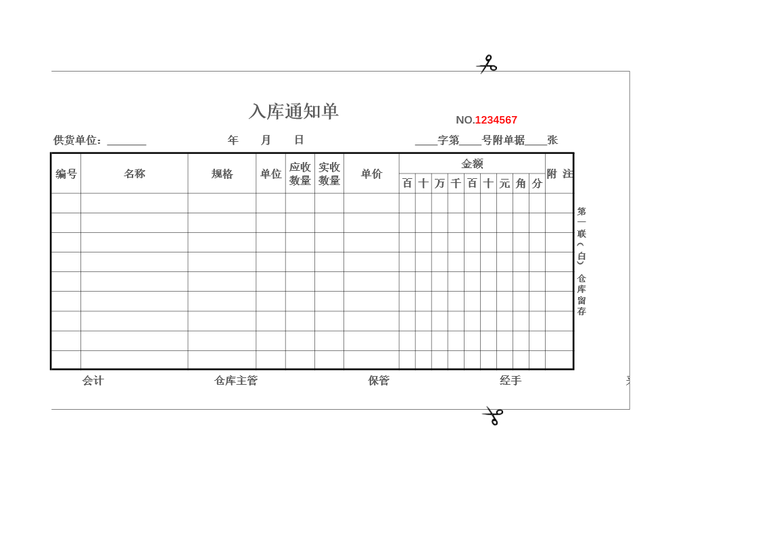
入库作业准备
图 3-3 入库通知单
图 3-3 入库通知单
图 3-3 入库通知单

Slide 10
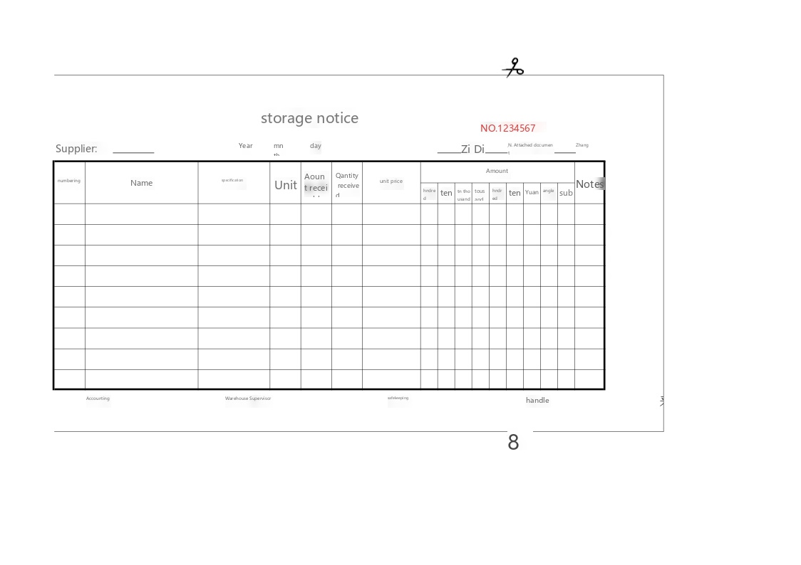
Preparation for warehousing operations
Figure 3-3 Warehousing Notification Form
Figure 3-3 Warehousing Notification Form
Figure 3-3 Warehousing Notification Form

Slide 11
二、制定入库计划
入库作业准备
1.制定入库计划的认知
入库作业计划是存货人发货和仓库部门进行入库前准备的依据，是指仓库部门在接受物品之前根 据本部门和存货人等内外部实际情况，权衡存货人的需求和仓库存储的可能性，通过科学分析入库货 物的品种、规格、数量、包装状态、包装体积、到货时间、物品存期、物品理化特性和保管要求以及 仓库存储能力、设备条件，编制的物品作业计划，并将作业计划下达到各相应的作业人员。

Slide 12
II. Development of the Warehousing Plan
Preparation for warehousing operations
1. Recognition of the Development of the Warehousing Plan
Warehousing operation plan is the basis for the stockist to deliver goods and the warehouse department to prepare before warehousing, refers to the warehouse department before accepting the goods according to the internal and external actual conditions such as the department and the stockist, weigh the needs of the stockist and the possibility of warehouse storage, through the scientific analysis of the variety, specification, quantity, packaging state, packaging volume, arrival time, article storage period, physical and chemical characteristics of the products and storage requirements and warehouse storage capacity, equipment conditions, the preparation of the operation plan. The operation plan will be sent to the corresponding operators.

Slide 13
入库作业准备
2.入库作业计划具体包括
（1）了解货物入库的时间、数量、包装形式、规格
（2）计划货物所需占用的仓容大小。
（3）预测车辆到达的时间及送货车型。
（4）为了方便装卸搬运，计划车辆的停放位置。
（5）计划货物的临时存放地点
（6）确定入库作业的相关部门。

Slide 14
Preparation for warehousing operations
2. The warehousing operation plan includes:
(1) Know the time, quantity, form of packaging, and specifications of the goods to be warehoused.
(2) The size of the warehouse space to be occupied.
(3) Predict the time of arrival of the vehicle and the delivery model.
(4) In order to facilitate loading and unloading, plan the parking location of the vehicle.
(5) Temporary storage locations for the planned goods.
(6) Identify the relevant departments for warehousing operations.

Slide 15
入库作业准备
3.入库计划表
计划内容 | 具体事项 | 负责部门 | 人员 | 设备需求
了解货物入库时间、数量、包装规格等 | 入库时间：6月5日，入库货物相关信息 | 仓储部 | 主管：张亮
计划货物的储位 | 根据该公司的实际储存情况确定货位： 胡姬花花生油储位分配：1号库 A区 011 蓝月亮洗衣液储位分配：1号库 B区 127 中华牙膏储位分配：1号库 B区 359 | 仓储部 | 收货组：王娜 | 堆高车：1辆 手动托盘搬运车：1辆 缠绕膜：1卷
预测车辆到达时间和送货车型 | 联系路路行货运有限公司确认到达具体时间和送货车辆车型 | 仓储部 | 收货组：李强
计划车辆的停放位置 | 为提高卸货效率，提前告知运输公司司机停靠具体位置。 | 仓储部 | 收货组：李强

Slide 16
Preparation for warehousing operations
3. Warehousing Schedule
Content | Specific Issues | Responsible Department | Personnel | Equipment Requirements
Know the time of entry of goodsinto the warehouse, quantities, packaging specifications, etc. | Warehousing time: June 5, related information of goods to be warehoused | Warehousing Department | Supervisor: Mr. Zhang Liang
Storage space for goods | Determination of goods space according to the actual storage situation of the company. Hu Ji Hua peanut oil storage space allocation: No. 1 warehouse A area 011 Blue Moon Laundry Detergent Storage Allocation: Warehouse 1, Area B 127 Zhong Hua toothpaste storage space allocation: Warehouse 1, Area B 359 | Warehousing Department | Receiving team: Wang Na | Stacker: 1 Hand Pallet Truck: 1 Winding film: 1
Predict vehicle arrival time and delivery models | Contact LuLuHang Freight Co., Ltd. to confirm the specific time of arrival and the model of the delivery vehicle | Warehousing Department | Receiving team: Li Qiang
Plan where to park vehicles | In order to improve the efficiency of unloading, the drivers of transportation companies are informed in advance of the exact location of the stop. | Warehousing Department | Receiving team: Li Qiang

Slide 17
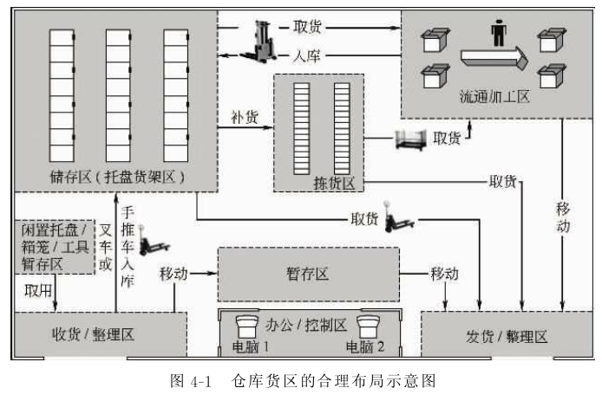
三、仓库内布局及设备
入库作业准备
1.仓库布局认知
熟悉仓库内部的区域划分及其功能，有利于高效完成仓储作业。根据作业需要，仓库通常划分为多个功能区，最常见的有收货区、储存区、拣货区、流通加工区、发货区等。
图 3-4 仓库内布局

Slide 18
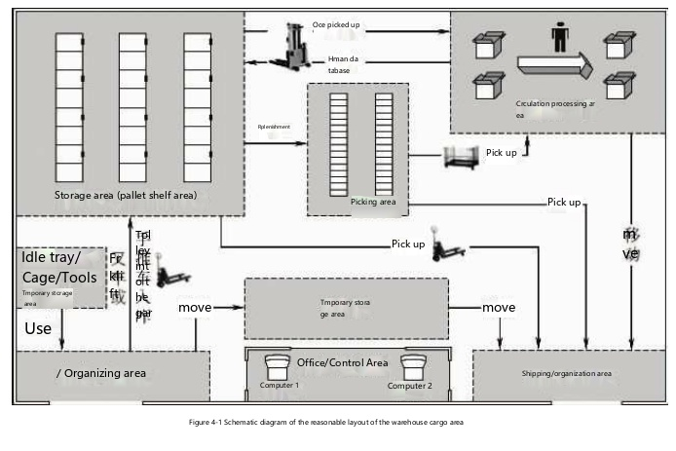
III. Layout and Equipment in the Warehouse
Preparation for warehousing operations
1. Warehouse Layout Recognition
Familiar with the internal division of the warehouse area and its function, is conducive to the efficient completion of warehousing operations. According to operational needs, the warehouse is usually divided into a number of functional areas, and the most common are receiving area, storage area, picking area, circulation processing area, shipping area.
Figure 3-4 Layout in the Warehouse

Slide 19
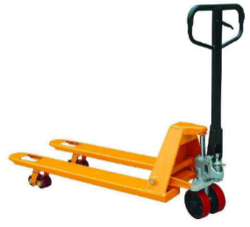
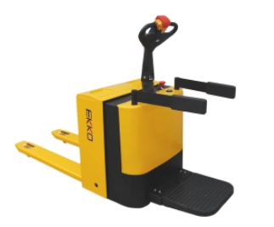
入库作业准备
2.卸货人员使用设备及工具
（1）托盘搬运车
托盘搬运车是一种轻小型搬运设备，它有两个货叉式的插腿，可插入托盘自由插孔内。叉腿的前端有两个小直径的行走轮，用来支撑托盘货物的重量。托盘搬运车广泛应用于仓库内外的物料装卸或车间内各工序间的搬运作业。具体可以分为手动托盘搬运车和电动托盘搬运车。
①手动托盘搬运车
在使用手动托盘搬运车时须将货叉插入托盘孔内，由人力驱动液压系统来实现托盘货物的起升和下降，并由人力拉动完成搬运作业。手动托盘搬运车如图3-5
②电动托盘搬运车
电动托盘搬运车以蓄电池为动力，直流电机驱动，液压工作站提升，操纵手柄集中控制，站立式驾驶。电动托盘搬运车如图 3-6
图3-5 手动托盘搬运车
图3-6 电动托盘搬运车

Slide 20
Preparation for warehousing operations
2. Equipment and Tools Used by Unloading Personnel
(1) Pallet Trucks
Pallet truck is a kind of light and small handling equipment, and it has two fork-type legs which can be inserted into the pallet free jack. There are two small-diameter walking wheels at the front end of the fork legs, which are used to support the weight of the palletized goods. Pallet trucks are widely used in the warehouse inside and outside the material handling or workshop handling operations between the various processes. It can be divided into manual pallet truck and electric pallet truck.
①Manual Pallet Truck
When using a manual pallet truck, the fork must be inserted into the pallet hole, and the hydraulic system driven by manpower can realize the lifting and lowering of the palletized goods, and the handling operation must be completed by manpower. The manual pallet truck is shown in Figure 3-5
②Electric Pallet Truck
Electric pallet truck is powered by battery, driven by DC motor, lifted by hydraulic workstation, centrally controlled by joystick, and driven by standing. Electric pallet truck as Figure 3-6
Figure 3-5
Manual Pallet Truck
Figure 3-6
Electric Pallet Truck

Slide 21
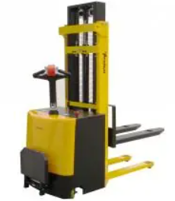
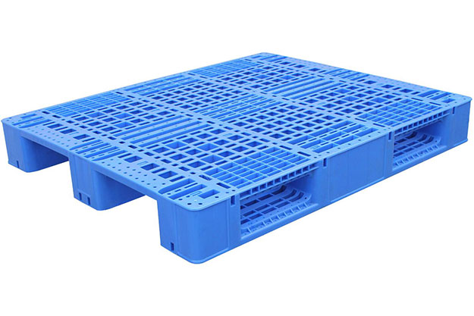
入库作业准备
（2）堆高车
堆高车是一种对成件托盘货物进行装卸、堆高、堆垛和短距离运输作业的轮式搬运车辆，主要由举升装置、移动装置和驱动装置构成，是高架仓库、库内装卸托盘化必不可少的设备。堆高车如图 3-7
（3）托盘
托盘是物流作业中必不可少的工具，是为了使物品能有效的装卸、运输、保管，将其按一定数量组合放置于一定形状的台面上，这种台面有供叉车从下部插入并将台板托起的插入口。托盘可以实现物品包装的单元化、规范化和标准化，加快装卸运输的速度，减轻工人的劳动强度，减少物品的磨损，方便物流和商流，实现仓储作业的现代化、机械化。托盘如图 3-8。
图3-7 堆高车
图3-8 托盘

Slide 22
Preparation for warehousing operations
(2) Stacker trucks
Stacker is a kind of wheeled handling vehicle for loading and unloading, stacking, stacking and short-distance transportation of palletized goods, which is mainly composed of lifting device, moving device and driving device, and is an indispensable equipment for loading and unloading palletization in high-bay warehouses and warehouses. The stacker is shown in Figure 3-7
(3) Pallet
Pallet is an indispensable tool in logistics operations, in order to make the goods can be effectively loaded, unloaded, transported, and kept, it is placed on a certain shape of the table according to a certain number of combinations, and this table has an insertion port for the forklift to insert from the bottom and hold up the platen. Pallets can realize the unitization, standardization and standardization of item packaging, speed up the speed of loading and unloading transportation, reduce the labor intensity of workers, reduce the wear and tear of items, facilitate logistics and business flow, and realize the modernization and mechanization of warehousing operations. The pallet is shown in Figure 3-8.
Figure 3-7 Stacker Truck
Figure 3-8 Pallets

Slide 23
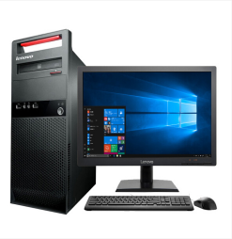
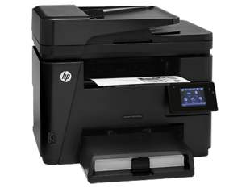
入库作业准备
（4）缠绕膜
在进行托盘堆码作业时，易碎品、外箱光滑、高价值货物必须使用缠绕膜，缠绕3层确保封紧，以确保货物在搬运、上架过程中的作业安全，防止货物滑落或倒塌，造成安全事故。如图3-9。
图3-9 缠绕膜
（5）电脑（已联网并安装【WMS】系统）及打印机
通过电脑（已联网并安装【WMS】系统）系统人员可完成制单、数据查询、业务跟踪等可进行系统操作，并使用打印机打印相关单据。如图3-10，3-11。
图3-10 电脑
图3-11 打印机

Slide 24
Preparation for warehousing operations
(4) Winding film
When pallet stacking operations, fragile goods, smooth outer boxes, and high-value goods must use stretch film, and wrap 3 layers to ensure tight sealing, so as to ensure the safety of the goods in the process of handling and shelfing, and prevent the goods from slipping or collapsing, resulting in safety accidents. See Figure 3-9.
Figure 3-9
Winding Film
(5) Computer (networked and with [WMS] system installed) and printer
The system personnel can complete the system operation, such as document preparation, data query, business tracking, etc.with the help of the computer (the network has been connected and the [WMS] system is installed), and use the printer to print relevant documents. See Figure 3-10, 3-11.
Figure 3-10 Computer
Figure 3-11 Printer

Slide 25
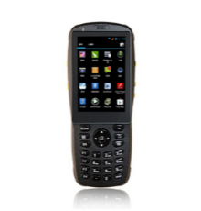
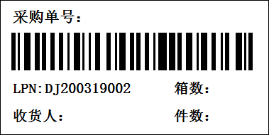
入库作业准备
（6）RF手持终端（已联网并安装【WMS】系统）
用来扫描条形码并记录的手持设备，通过其自身带的激光头、红外头来对条码进行识别。作为库内作业的操作工具。如图
LPN标签：LPN是一种将货物容器的编号通过软件转换成的条码。LPN标签用于绑定货物进行跟踪及转移。
图3-12 RF手持终端
（7）开箱器及记号笔
图3-13 LPN标签
收货组员进行清点实物数量时，需要进行货物验收，通常会使用到开箱器划开外包装箱，已清点、验收完毕后会使用记号笔在该托盘货物LPN标签上登记本次收货数量。
（8）订书机、归纳盒、装单箱
图3-14 记号笔
主要用于单据整理，具体为收货组员将整理的收货单据（包含退货单、退货入库单），按日期归类装订好，并在固定位置（左上角）粘贴日期标签，放置在指定归纳盒中。
图3-14 开箱器

Slide 26
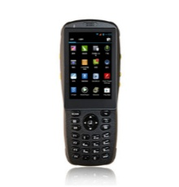
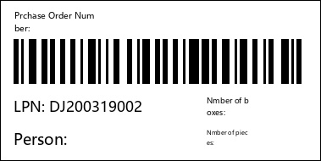
Preparation for warehousing operations
(6) RF handheld terminal (networked and installed with [WMS] system)
A handheld device used to scan and record barcodes can identify barcodes through their own laser and infrared heads. It is used as an operation tool for in-library jobs. See Figure 3-12.
LPN label: LPN is a barcode that converts the number of the container of goods into a barcode through software. The LPN tag is used to bind the goods for tracking and transfer.
Figure 3-12
RF Handheld Terminal
(7) Box openers and markers
When the receiving team members count the physical quantity, they need to carry out the acceptance of the goods, usually use the unpacking device to cut the outer packing box, and after the inventory and acceptance are completed, they will use a marker pen to register the received quantity on the LPN label of the pallet of goods.
Figure 3-13
LPN Labeling
(8) Staplers, induction boxes, order boxes
It is mainly used for document sorting, specifically for the receiving team members to sort out the receipt documents (including return orders, return warehousing orders), classify and bind them according to the date, and paste the date label in a fixed position (upper left corner) and place them in the designated induction box.
Figure 3-14 Markers
Figure 3-14 Opener

Slide 27
谢谢观看

Slide 28
Thanks for listening

